Slide 1
Decoding NFL Injuries Risk Factors, Recurrence & Predictive Insights
Group – 9
Ifeanyichukwu Ezeanyagu
Aditya Keshavapatnam
Jaxon Norton
Parishkrit Lama

Slide 2
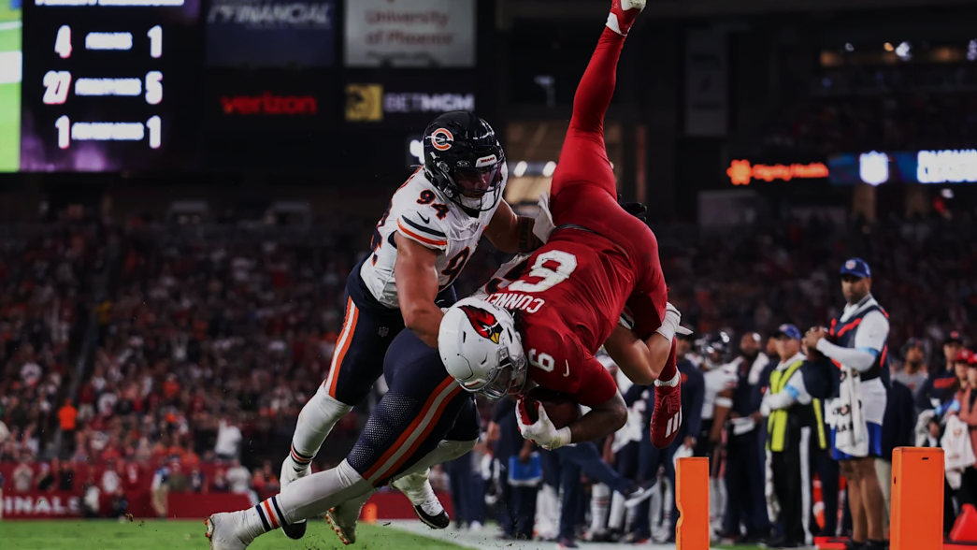
What is NFL ?

Slide 3
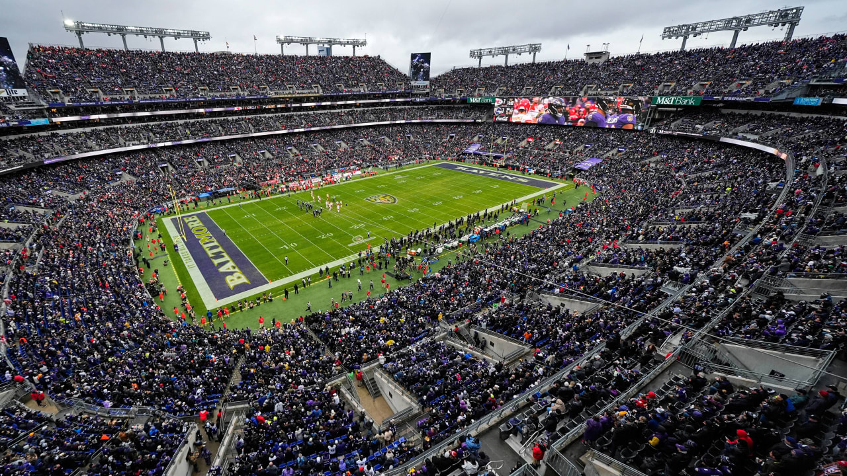
Player Positions in NFL
DB - Defensive Back
OL - Offensive Lineman
DL - Defensive Lineman
WR - Wide Receiver
LB - Linebacker
RB - Running Back
TE - Tight End
QB - Quarterback
K - Kicker
P - Punter
LS - Long Snapper

Slide 4
Literature Review
There is a plethora of existing literature about NFL injuries
Injury Prevalence
Lower extremity injuries are the most prevalent types of injuries sustained (Venishetty et al., 2024)
Specifically, knee injuries were the most common injuries seen in 2015-2018 (Mack et al., 2020)
Other prevalent lower extremity injuries include ankle, thigh, foot, and hamstring injuries (Mack et. All, 2020)
Anterior Cruciate Ligament (ACL) injuries have an average recovery time of 11 months (Shah et al., 2010)
Return to play rate is 55% (Mody et. All, 2022)
Achilles injuries can take six to twelve months to heal (Ready at al., 2019)
61% return to play rate at pre-injury level (Yang et al., 2019)

Slide 5
Literature Review
Positional injury
Wide Receivers, Safeties, and Linebackers saw the highest rate of injury (Baker et al. 2021)
Positions require extensive running, change of direction, and accelerations (Schick et al., 2023)
Playing Surface
Artificial Turf introduced in 1964
Increases in overall injuries, season-ending injuries, and surgeries playing on turf (Venishetty et al., 2024)
Division II and III athletes experienced significant knee injuries at 1.63 times the rate on turf (Loughran et all. 2019)
Injury History/Re-occurence
ACL injuries and ankle sprains see higher injury reoccurrence rates (Venishetty et al., 2024)
Athletes with concussion history see 7% annual income loss post-injury, impacting future employment opportunities (Keefer & Kniesner, 2023)
All of these are factors that will be further investigated in determining report status

Slide 6
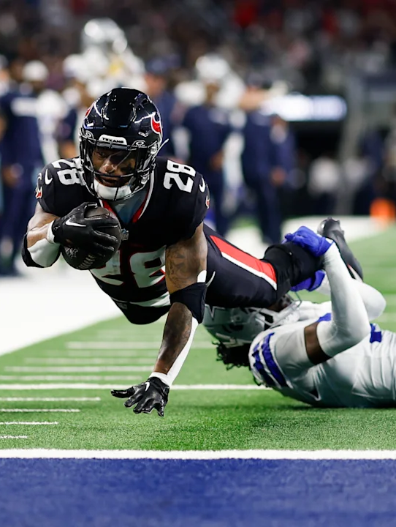
Data Collection & Preparationlection
NFL Verse API
Individual team websites to identify their practice facility.
Replace missing values with appropriate value.
Drop unnecessary data.
Categorize the injuries into 7 categories.

Slide 7
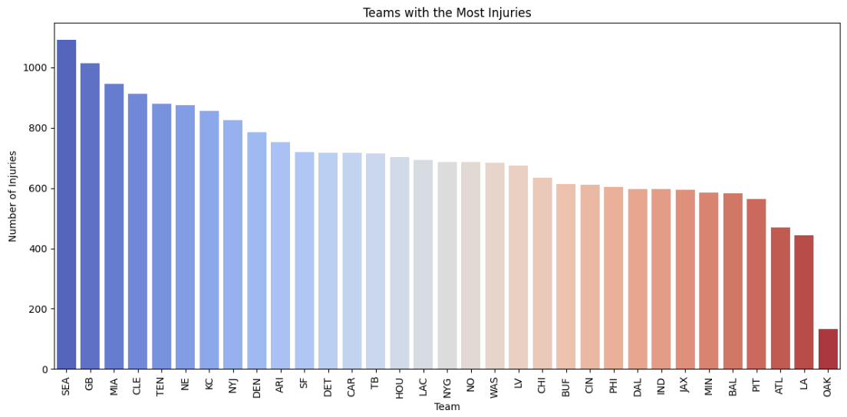
Total injuries by teams for the past 5 years
The Seahawks (SEA)(3 Po), Packers (GB)(4Po), and Dolphins (MIA)(2Po) top the list with over 900 injuries, indicating potentially higher exposure or reporting injuries.
Teams such as the Chiefs(KC), Bills(BUF), Packers(GB), Ravens(BAL), and 49ers(SF) have been consistent playoff contenders over the past five seasons.

Slide 8
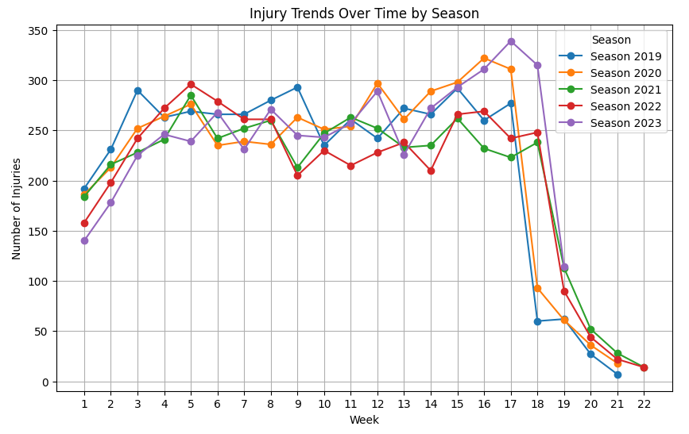
Injury trends over time by season
Weeks 16,17,18 reach highest number of injuries.

Slide 9
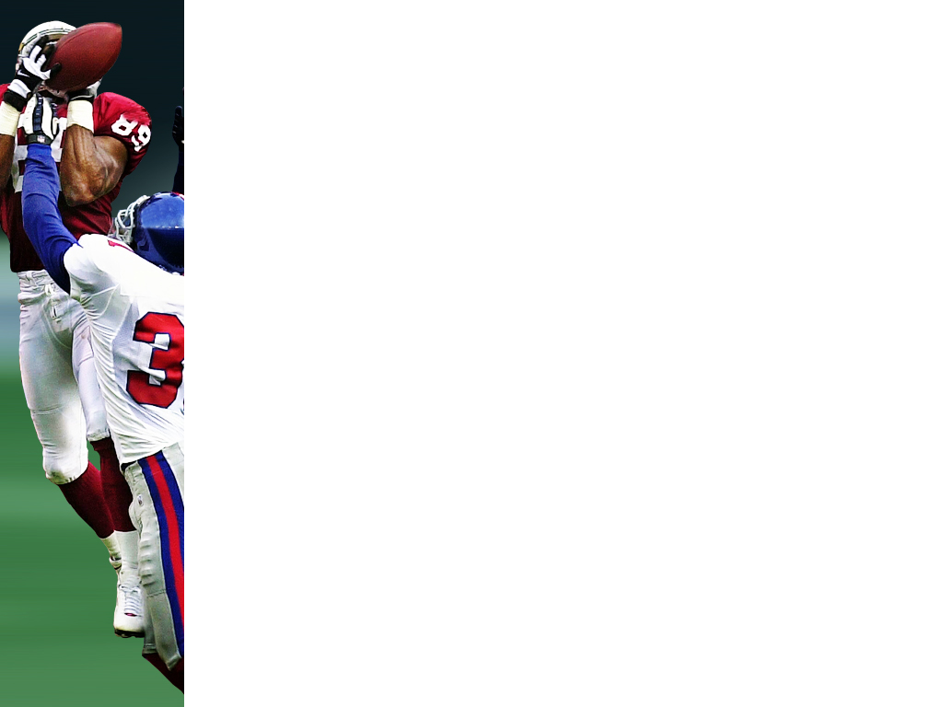
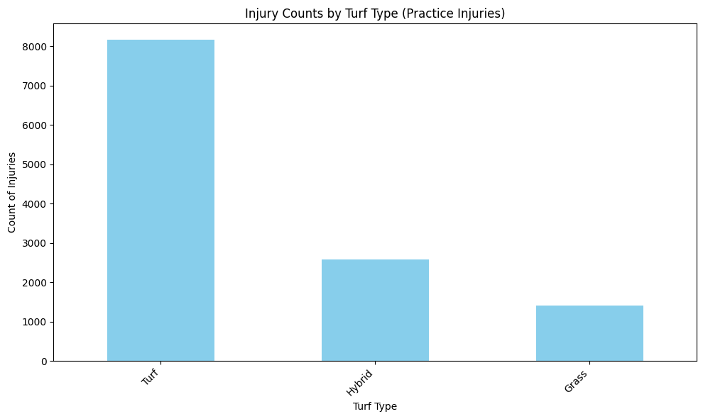
Injury Counts by Turf Type
Players encountered more injuries on artificial turf compared to Hybrid and Grass.

Slide 10
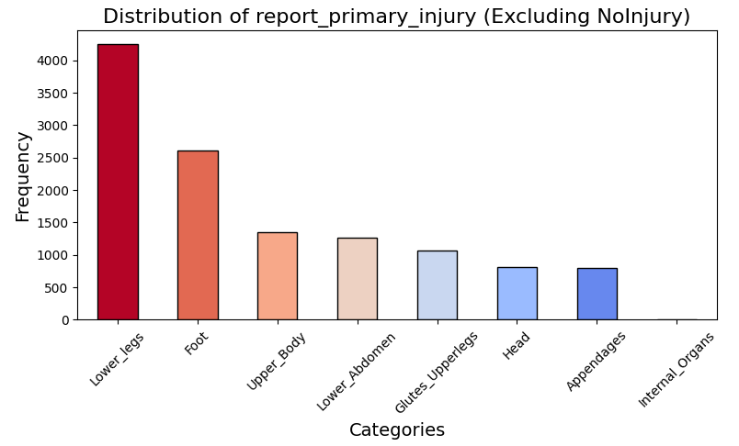
Injury Prevalence
Lower legs, foot, Upper body are the top 3 most common injuries.

Slide 11
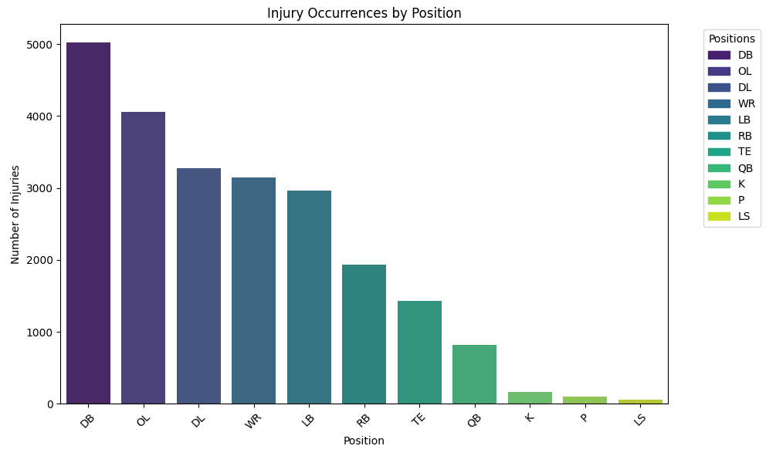
Injury Occurrences by Position
Defensive Backs(DB) faced the most amount of followed by OL, DL and WR.

Slide 12
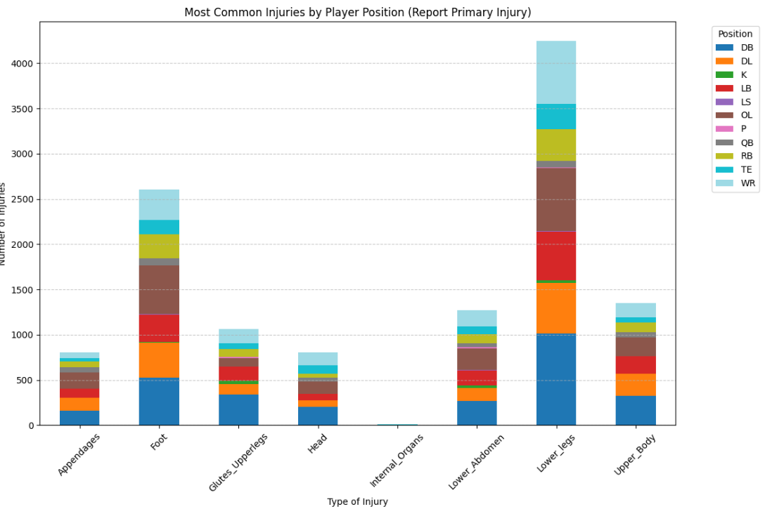
Injury Prevalence by Position
Defensive Backs(DB) faced the greatest number of injuries across all categories followed by OL, DL and WR.

Slide 13
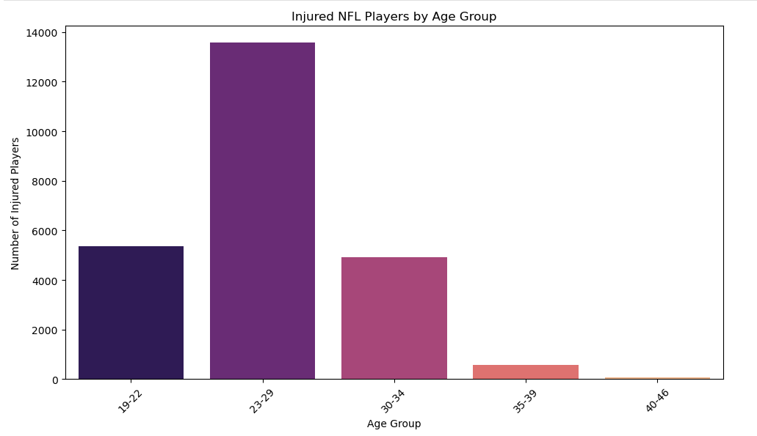
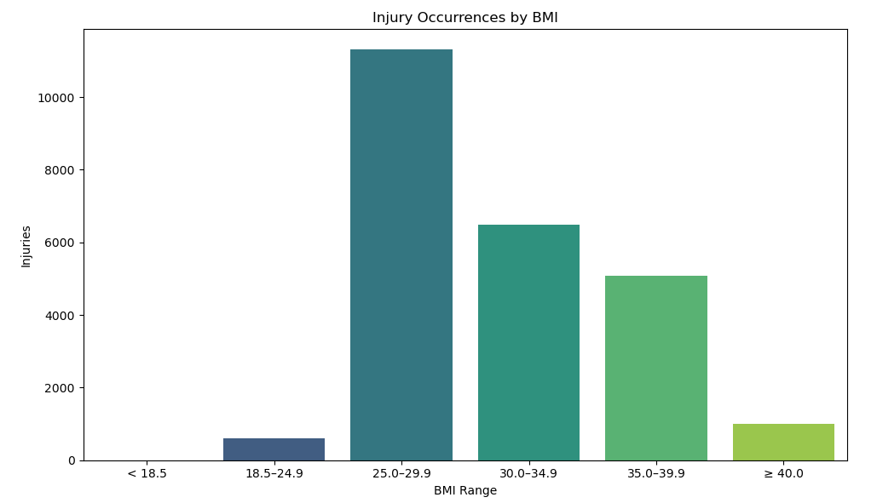
Injury Occurrences by Age Group and BMI
Players aged 23-29 are most susceptible to encounter injuries, followed by 19-22, and 30-34.
Players with a BMI Range of 25 – 29.9 face more injuries followed by 30 -34.9 and 35 – 39.9.

Slide 14
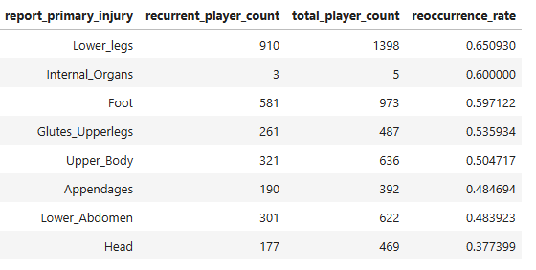
Injury Recurrence
Lower leg injuries showed the highest reoccurrence rate at 65.1%, followed by foot injuries at 59.7%, emphasizing the significant risk and recurrence associated with lower extremity injuries among NFL athletes. This is consistent with findings by Venishetty et al. (2024), who identified lower leg injuries as particularly prone to recurrence among athletes.

Slide 15
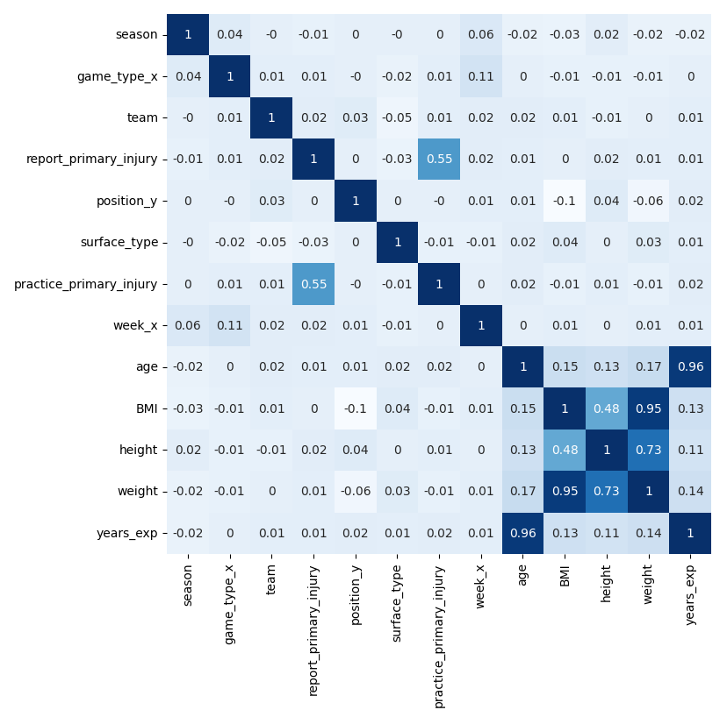
Predictive Factor Analysis
Age and Years of experience, BMI and Height, Weight are highly correlated.

Slide 16
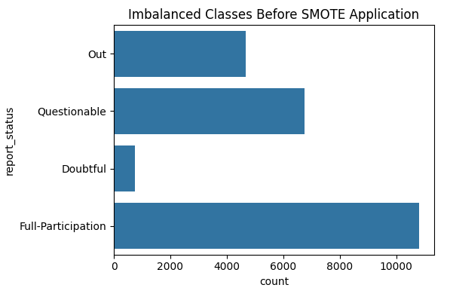
Predictive Factor Analysis
The target class is highly imbalanced.
Implement SMOTE resampling.

Slide 17
Hypothesis Testing
The Null Hypotheses (H₀): H₀: report status - season = 0 (Null Hypothesis) H₀: report status – game type = 0 (Null Hypothesis) H₀: report status - team = 0 (Null Hypothesis) H₀: report status – report primary injury = 0 (Null Hypothesis) H₀: report status - position = 0 (Null Hypothesis) H₀: report status – surface type = 0 (Null Hypothesis) H₀: report status – practice primary injury = 0 (Null Hypothesis)
Alternate Hypotheses (H₁):
H₁: report status - season ≠ 0 (Alternate Hypothesis)
H₁: report status - game type ≠ 0 (Alternate Hypothesis)
H₁: report status - team ≠ 0 (Alternate Hypothesis)
H₁: report status – report primary injury ≠ 0 (Alternate Hypothesis)
H₁: report status - position ≠ 0 (Alternate Hypothesis)
H₁: report status - surface type ≠ 0 (Alternate Hypothesis)
H₁: report status – practice primary injury ≠ 0 (Alternate Hypothesis)

Slide 18
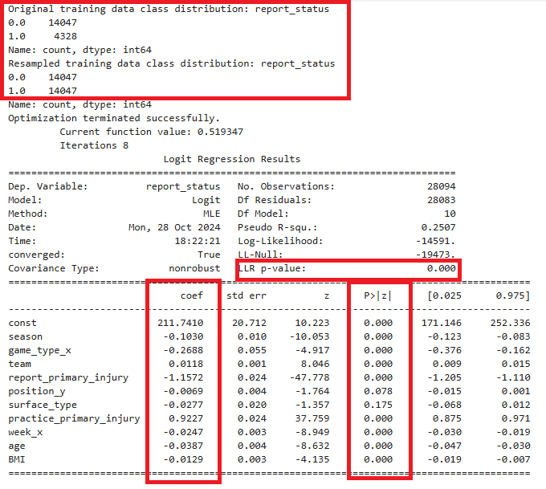
Hypothesis Testing
Player position and Surface Type are not significant.

Slide 19
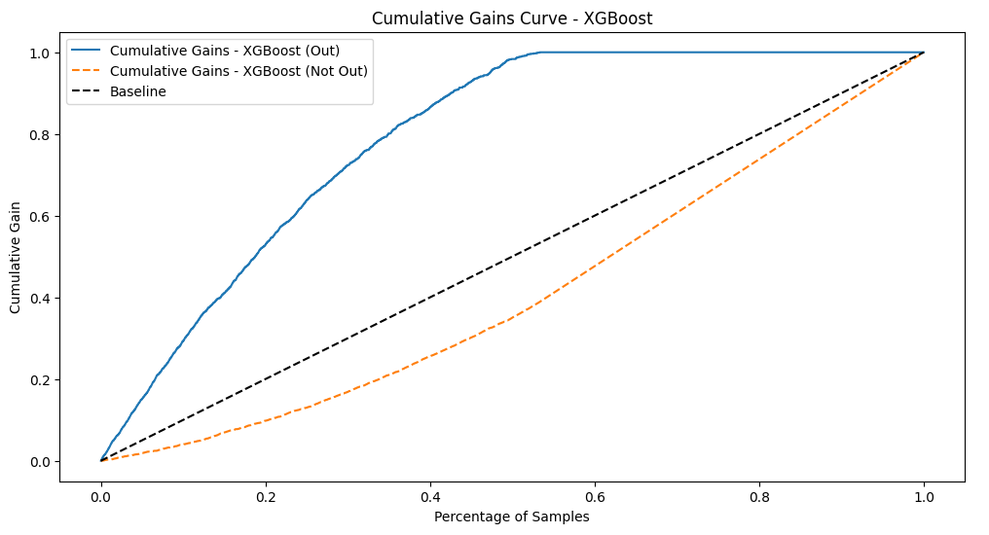
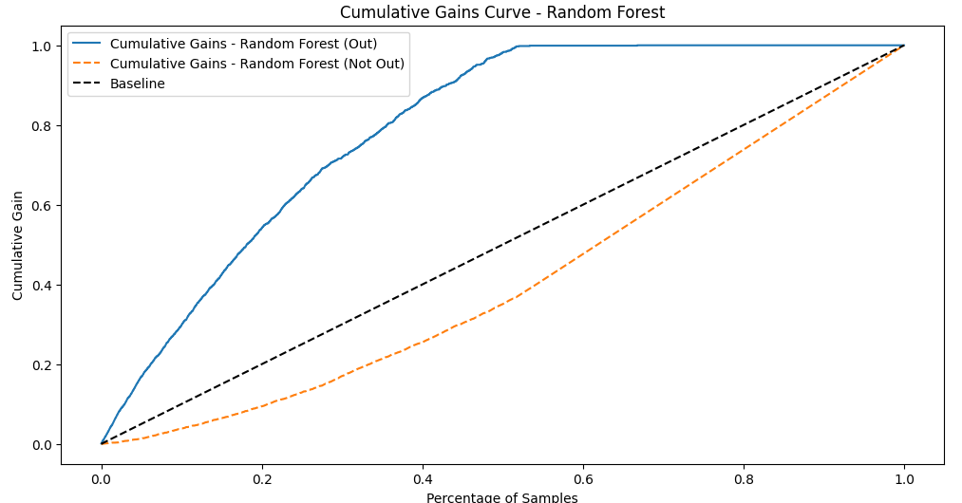
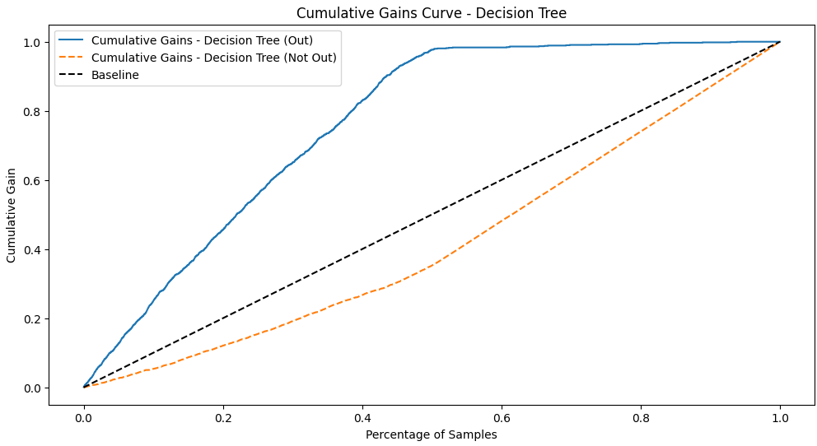
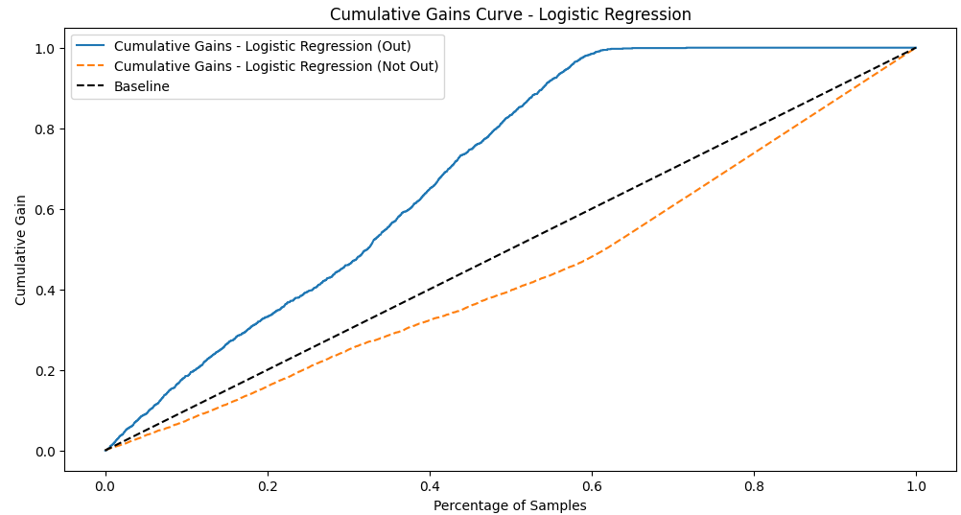
ML Model Performance
Gains Curves

Slide 20
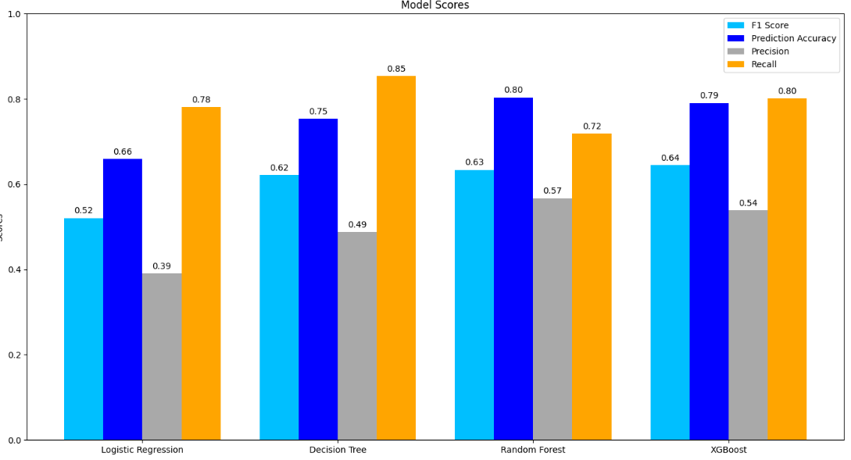
ML Model Performance
Overall best model in predicting the report status was XGBoost followed by Random Forest- F1 score
F1 Score focuses on balance between recall and precision.
F1 Score – essential for imbalanced dataset , minimize FP & FN, FP & FN have significant consequences.
F1 score = 2 × ( ( precision × recall) / ( precision + recall))

Slide 21
Limitations
About 120 different NFL injuries types – Broad categorization.
Lack of treatment data from various teams.
Different teams – Different treatment strategies
Effective injury prevention & treatment difficulty
Vague individual injury reporting status - "Out", "Questionable“
Time loss for out of status – full participation difficult
Limited dataset / information
Difficult to pinpoint the type of fields (turf, hybrid or natural)

Slide 22
Recommendations
Incorporate comprehensive and granular player data.
Improved data collection
Training loads, injury treatment information
Standardized treatment reporting protocols
Granular injury classification NOT broad classification
Advanced modelling techniques
Deep Learning or ensemble methods - Model performance
Incorporate external data
Weather, game intensity
Predictive power

Slide 23
References
Baker, H. P., Pirkle, S., Cahill, M., Reddy, M., Portney, D., & Athiviraham, A. (2021). The injury rate in National Football League players increased following cancellation of preseason games because of COVID-19. Arthroscopy, Sports Medicine, and Rehabilitation, 3(4), e1147-e1154. https://doi.org/10.1016/j.asmr.2021.05.002
Keefer, Q. A. W., & Kniesner, T. J. (2023). Injury risk, concussions, race, and pay in the NFL. Journal of Risk and Uncertainty, 67, 107–136. https://doi.org/10.1007/s11166-023-09415-1
Loughran, G. J., Vulpis, C. T., Murphy, J. P., Weiner, D. A., Svoboda, S. J., Hinton, R. Y., & Milzman, D. P. (2019). Incidence of knee injuries on artificial turf versus natural grass in National Collegiate Athletic Association American football: 2004-2005 through 2013-2014 seasons. The American Journal of Sports Medicine,47(6),1294-1301. https://doi.org/10.1177/0363546519833925
Mack, C. D., Kent, R. W., & Coughlin, M. J. (2020). Incidence of lower extremity injury in the National Football League: 2015 to 2018. The American Journal of Sports Medicine, 48(9), 2287–2294. https://doi.org/10.1177/0363546520922547
Mody, K. S., Fletcher, A. N., Akoh, C. C., & Parekh, S. G. (2022). Return to play and performance after anterior cruciate ligament reconstruction in National Football League players. Orthopaedic Journal of Sports Medicine, 10(3). https://doi.org/10.1177/23259671221079637

Slide 24
References
Ready, L. V., Li, N. Y., Worobey, S. J., Lemme, N. J., Yang, J., & Owens, B. D. (2019). Misconceptions in NFL injuries: A study on the Achilles. Foot & Ankle Orthopaedics, 4(4). https://doi.org/10.1177/2473011419S00352
Shah, V. M., Andrews, J. R., Fleisig, G. S., McMichael, C. S., & Lemak, L. J. (2010). Return to play after anterior cruciate ligament reconstruction in National Football League athletes. The American Journal of Sports Medicine,38(11),2233-2239. https://doi.org/10.1177/0363546510372798
Schick, S., Cantrell, C. K., Young, B., Mosher, Z., Ewing, M., Elphingstone, J. W., Brabston, E., Ponce, B. A., & Momaya, A. M. (2023). The mechanism of anterior cruciate ligament injuries in the National Football League: A systematic video review. Cureus,15(1),e34291 https://doi.org/10.7759/cureus.34291
Venishetty, N., Xiao, A. X., Ghanta, R., Reddy, R., Pandya, N. K., & Feeley, B. T. (2024). Lower Extremity Injury Rates on Artificial Turf Versus Natural Grass Surfaces in the National Football League During the 2021 and 2022 Seasons. The Orthopaedic Journal of Sports Medicine, 12(8). https://doi.org/10.1177/23259671241265378
Yang, J., Hodax, J. D., Machan, J. T.(2019). Factors affecting return to play after primary Achilles tendon tear: A cohort of NFL players. Orthopaedic Journal of Sports Medicine, 7(3). https://doi.org/10.1177/2325967119830139

Slide 25
THANK YOU !!
This presentation was designed using a template from PoweredTemplate.com

